Slide 1
CASE
Name: PN
Age: 32
G4p3+0
GBD 31weeks, admitted at 29weeks
Known DM since 2016
Rx Mixtard 20IUam and 10IUpm
Hx of not being compliant with Rx due to lack of funds for transportation and refill
ANC
ANP unremarkable
Normal BPs with ANC attendance
RBS 20.0 in 18/5/24 on Mixtard 20IUam and 10IUpm
NB RBS 30.0 on 21/7/24 - pt had gone 10days without Rx and referred
Rx 1.5l N/S???+ Mixtard 40IU SC and referred
No early nor anomaly US

Slide 2
RBS on admission 22.2mmol/l
OE – FGC, no respiratory distress, no jaundice, no pallor, no edema
BP 109/60mmhg
FH 30weeks, FHHR
NST – reactive
US SIUP at 29wks+1/7, BPP 8/8, UA dopplers –normal, polyhydramnios with AFI 13cm
CBC, LFTs and UECs - unremarkable to date

Slide 3
Started on insulin 0.9iu/kg (split into 50% lantus and 50% lispro TDS)
Rx :
Lantus 32IU 10pm, 10IU TDS
currently :
Lantus 44IU 10IU pm, 21IU am, 21IU prelunch, 19IU pm
Metformin 500mg BD
Today :
Lantus 36IU pm, Lispro 12IU TDS
Metformin 1g BD
US 15/8/24 SIUP at 31wks+5/7, EFW 1895gms, UA dopplers - normal, AFI 14.8cm
NB: AC >88%, BPD, HC and FL normal centiles

Slide 4
M/T and Delivery plan
CBC, LFT and UECs - twice weekly
Weekly UA dopplers
Growth US every 2 weeks
Contraception counselling
Preconception counselling
Delivery at 38weeks depending on above monitoring
Pt counselled on possibility of CS with increasing AC to prevent birth trauma due to possible shoulder dystocia.
Reduce insulin doses by 50% after delivery and close monitoring
Initiate breastfeeding immediately and Neonatology review

Slide 5
Diabetes Mellitus in Pregnancy
Dr Mutindi Kakuti
15/8/24

Slide 6
Diabetes Mellitus
10% Type 1
Early onset
Insulin deficiency
Insulin dependent
Usually T cell mediated autoimmune disorder against the beta cells that produce insulin from the pancreas
Genetically susceptible person in concert with a trigger
Insulin deficiency – elevated BG
S/S – polyphagia, polydypsia, glycosuria, polyuria
Type 2
More common 90%
Late onset
Increased insulin resistance( cells not taking up glucose)> increased BS
Increased BS > increased insulin production> hypertrophy of beta cells and increased production of amylin which causes dysfunctional beta cells
Finally hypotrophy of beta cells> decrease in insulin production

Slide 7
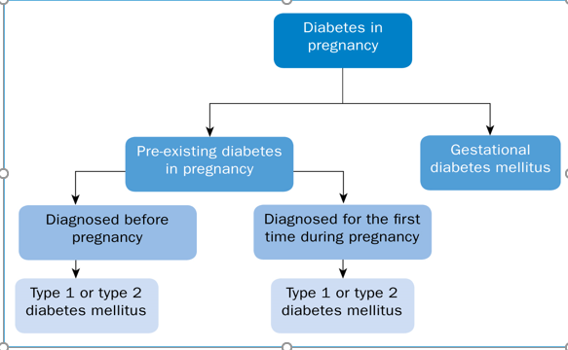
Classification of DM

Slide 8
Gestational DM
GDM is defined as glucose intolerance diagnosed during pregnancy that is not clearly preexisting diabetes.
The underlying pathophysiology of GDM in most instances is similar to that observed for T2DM: an inability to maintain an adequate insulin response because of the significant decreases in insulin sensitivity with advancing gestation.
5% to 9% of pregnant women will be diagnosed with GDM
B-cell Hyperplasia, decreased insensitivity/ increased resistance.
hCS (human Chorionic Somatostatin)/hPL Human Placental Lactogen – strongest antagonist of pregnancy.
Cortisol, Progesterone, Prolactin, Growth Hormone

Slide 9
Criteria for diagnosis
IADPSG (International Ass. For Diabetes in Pregnancy Study Group)criteria for GDM diagnosis .Adopted by WHO, ADA but not ACOG (2 step 50g GT then 100gm OGTT)
1ST ANC VISIT:
All should have RBS done (screening)
75g OGTT and Hba1C for high risk patients, Hba1C >5.7% in 1st trimester was predictive of a dx of GDM
Overt DM - Hba1C >6.5%
FBS >7.0mmol/l after 8hr fast
2hr PP >11.1mmol/l after 75g glucose challenge test
IADPSG criteria able to pick more women with GDM —up to 18% using the new criteria, compared to 5% to 10% with the two-step 3-hour OGTT system
ADA and IADPSG recommend any one value as Dx for GDM

Slide 10
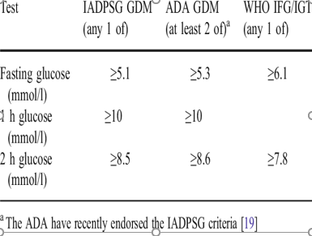
Diagnostic criteria for DM diagnosis

Slide 11
Risk factors
BMI above 25 - 30kg/m2
Previous Macrosomia infant Weight > 4.5kg
Previous Gestational diabetes.
Family history of diabetes (First degree relative with diabetes
High-risk race/ethnicity
Women with PCOS
Hypertension
Dyslipidemia ( HDL , 35mg/dl, Triglyceride > 250mg/dl
History of Cardiovascular disease,
Previous HbA1C > 5.7%
Glycosuria

Slide 12
Maternal complications of DM/GDM
Higher rates of Miscarriages
Higher rates of Polyhydramnios and Macrosomia (>4 kg or wt. centile >90) appr 10-20%
Higher rates of Preterm labour
Higher risk of intrauterine foetal demise
Higher rate of Birth Trauma, perineal Injuries and Shoulder dystocia
Higher rate of Childhood & adult obesity, glucose intolerance, Type 2 diabetes and Cardio vascular complications.
Risk of worsening of Retinal and renal diseases.
Diabetic Ketoacidosis especially for Type one diabetes (Rare in pregnancy)
IUGR with long term DM with diabetic vasculopathy or ass, PET

Slide 13
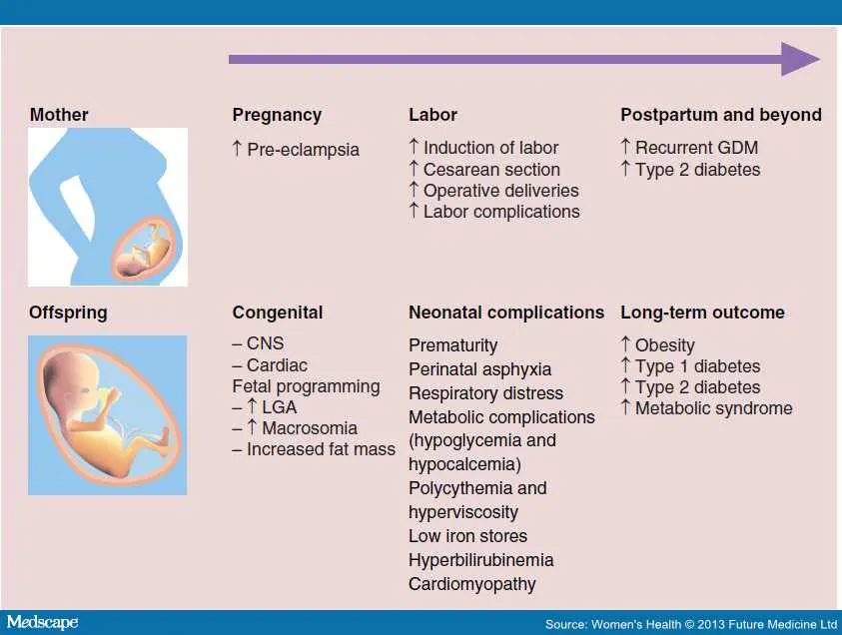
Fetal/ Neonatal complications

Slide 14
Macrosomia
Major complication – shoulder dytocia
Maternal hyperglycemia> fetal hyperglycemia> fetal Hyperinsulinemia>fat deposition
In the DIEP study, birth weight correlated best with second- and third-trimester post-prandial glucose measures.
When 2-hour postprandial glucose measures averaged 6.6mmom/L or less, approximately 20% of infants were macrosomic,
When 2-hour postprandial glucose measures averaged up to 6.6mmom/L, the rate of macrosomia reached 35%.
HAPO study showed that the fasting as well as the 1- and 2-hour glucose values at the time of the OGTT at 24 to 32 weeks’ gestation had a significant linear correlation with both birth weight and fetal adiposity.

Slide 15
Long term complications
RETINOPATHY - Some form of retinopathy is present in virtually 100% of women who have had T1DM for 25 years or more
NEPHROPATHY - Diabetes is the most common cause of end-stage renal disease(ESRD) , accounting for 44% of all new cases of kidney failure. Worsened by duration of DM, uncontrolled DM and concurrent HTN
CVS – ARTHEROSCLEROSIS - Although it is uncommon, atherosclerotic heart disease may afflict diabetic patients in the later reproductive years

Slide 16
Management - preconeption
Recommendations:
Use a multidisciplinary pre-conceptional care team. Ensure well controlled BS, change of Rx to recommended Rx in pregnancy - ACE inhibitors, Statins, Diuretics, B-blockers, ARBs etc
Aim for HbA1C < 6.5% and FBS <5.3, 1hr PP 7.8mmol/l and 2hr PP 6.7mmol/l .
If HbA1C is > 10% risk of anomalies and miscarriage( Counsel of risk)
If planning to get pregnant with poorly controlled BS – 1st choice INSULIN Rx
Perform a full medical and obstetric evaluation in the pre-conceptional period to assess risks. ECG/ ECHO, UECs ,Fundoscopy, TFTs
Folic Acid
Aspirin 150nocte from 12wks gestation

Slide 17
ANC Management
Risk assessment from Hx taking.
Identify those with risk factors at 1st ANC - and do 75g OGTT between 24 to 28weeks
Ideally GDM screening for all 24-28weeks. Not ideal in all setting with cost implications
Folic Acid
Jnr Aspirin
Detailed anomaly US between 18-22weeks
Growth US every week till 28wks, 2 weekly+ doppler US from 28-36weeks, weekly from 36weeks
Nutritional counselling
Monitor appropriate weight gain
30min exercise daily

Slide 18
Timing of glucose monitoring
because postprandial values have a strong correlation with fetal growth and development of macrosomia.
The DIEP study reported that, when 2hr postprandial glucose values :
6.6mmol/L, approximately 20% of infants were macrosomic
30% rise in postprandial glucose averaging 8.8mmoml/L resulted in a 35% rate of macrosomia.
In the HAPO study, FPG levels during the OGTT, as well as the 1- and 2-hour glucose concentrations, were strong correlates with fetal birth weight and adiposity.

Slide 19
Target blood sugars for M/T of DM in pregnancy
TARGET GLUCOSE LEVELS - . For women with pregestational T1DM or T2DM, both ACOG and the ADA recommend the following as glycemic goals if they can be achieved without excessive hypoglycemia:
Fasting <5 mg/dL (5.3 mmol/L) and either
One-hour postprandial <140 mg/dL (7.8 mmol/L) or
Two-hour postprandial <120 mg/dL (6.7 mmol/L)

Slide 20
Metformin
Class B, enhances hepatic and peripheral insulin sensitivity
oral hypoglycemic recommended for use in pregnancy other than metformin
The use of metformin in infertile patients with PCOS) has been reported to lead to higher conception rates, lower miscarriage rates, and higher live birth rates.
Metformin readily crosses the placenta, exposing the fetus to concentrations approaching those in the maternal circulation

Slide 21
Insulin
The goal of insulin Rx is to achieve diurnal glucose excursions similar to those of nondiabetic pregnant women.
The regimens must be modified continually as pregnancy progresses and as insulin resistance rises.
This is the optimal intervention to avoid macrosomia and neonatal morbidity.
Delaying definitive therapy while attempting to correct a suboptimal glucose profile with dietary and oral medication adjustments may miss the time when glycemic intervention is most likely to moderate fetal growth.

Slide 22
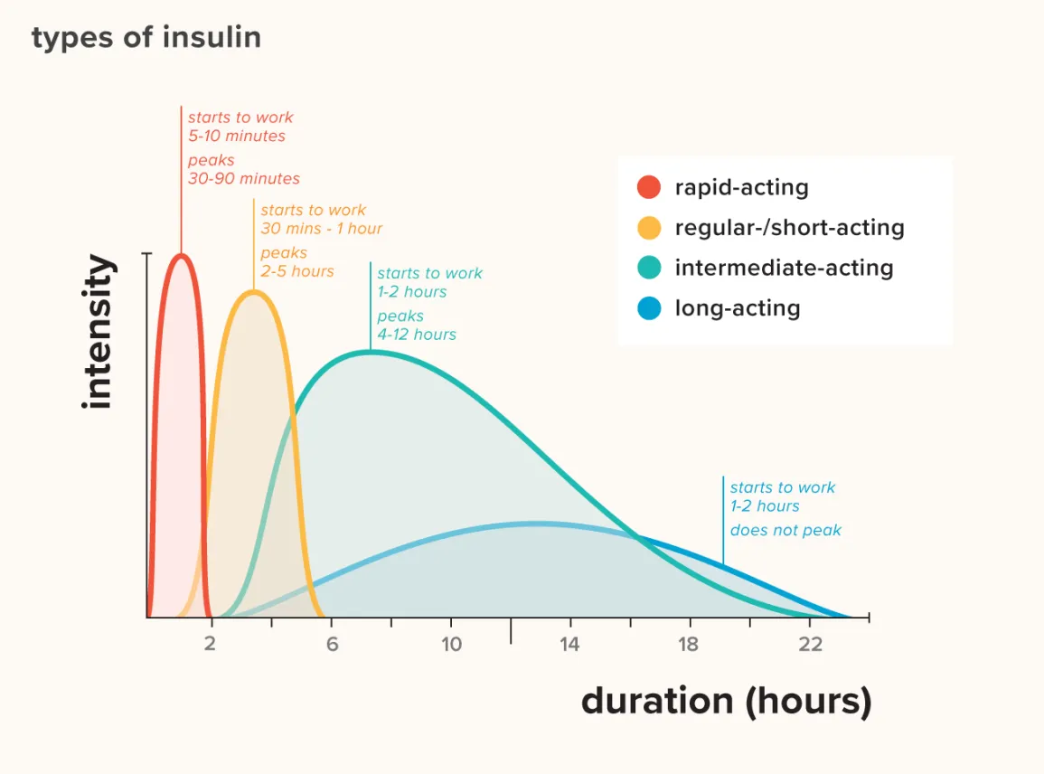
Activity profiles for different types of insulin

Slide 23
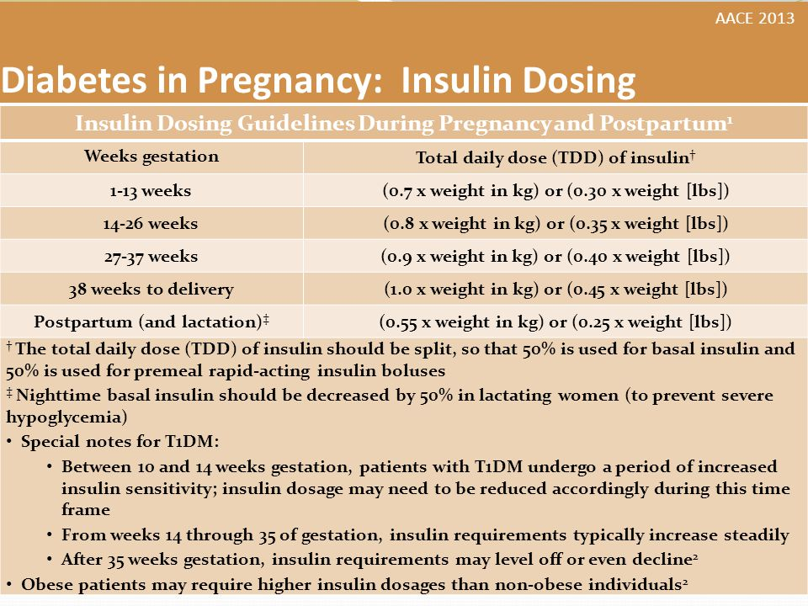
Insulin dosing…

Slide 24
ADA recommendations for M/T of DM in pregnancy
Fasting and post-prandial self monitoring of blood glucose are recommended
Adjustments : 10% insulin adjustments/ 0.7-2units/day till gylcemic target is achieved
Some women with PGDM should also check glucose pre-prandially.
With adjustments - FIX FASTING BLOOD SUGARS FIRST!!!!
NB: Due to increased RBC turn over , A1C target in pregnancy is 7% to prevent hypoglycemia
Continuous monitoring twice a day

Slide 25
Timing of Delivery
Delivery at 38weeks38/40 for those with pre-gestational diabetes)
Uncomplicated GDM deliver prior to 40/40
If fetal/maternal complication including uncontrolled diabetes consider earlier delivery.
US – monitor fetal well being
monthly till 28wks
every 2 weeks from 28-36weeks
weekly till delivery
For US Dx macrosomia counsel regarding induction and delivery.
MONITOR FM
If admitted daily NST
Corticosteroids if delivery is <37weeks for lung maturity

Slide 26
Intrapartum M/T
INSULIN INFUSION METHOD
Withhold a.m. insulin injection.
Begin 5% dextrose in water) at 100 mL/h throughout labor.
Begin infusion of regular insulin at 0.5 U/h.
Begin oxytocin as needed.
Monitor maternal glucose levels hourly at bedside or laboratory
Adjust insulin infusion
INTERMITTENT SUBCUTANEOUS INJECTION METHOD
Give one-half of the usual insulin dose in a.m.
Begin (5% dextrose in water) at 100 mL/h throughout labor.
Begin oxytocin as needed
Administer regular insulin in small doses (2–5 U) to maintain glucose levels of 4.4-6.6mmol/l

Slide 27
Postpartum M/T
The basal and bolus insulin doses required after delivery are typically 30% to 50% of the doses required during pregnancy
T1DM patients require more intensive glucose monitoring after delivery, because many experience a “honey-moon” phase in which insulin requirements fall dramatically.
For GDM, OGTT at 6 and 12 weeks after delivery
TAKE NB : Counselling points
- GDM in a subsequent pregnancy: (30-60%)
- T2DM : (20%) at 5 years, (50%) at 10 years
- Pre- diabetes (HAPO) 39.4 %
- 2 times higher risk of Cardiovascular disease.

Slide 28

ASANTE SANA!!!!

